Slide 1
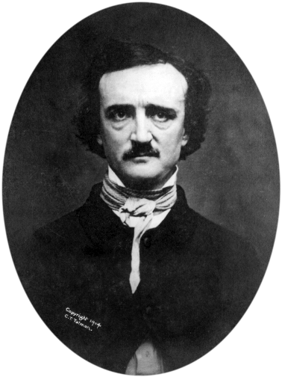
“Human ingenuity cannot concoct a cipher which human ingenuity cannot resolve.”
Edgar Allan Poe, 1841

Slide 2
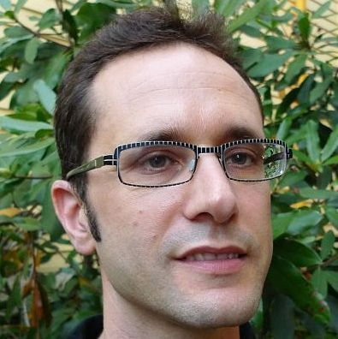
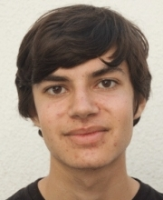
CS-127 / CSCI E-127: Cryptography
Tue-Thu 10:30am-1:00pm, Maxwell Dworkin G-125
Boaz Barak
Tudor Giurgica-Tiron
Nathan Manohar
Mark Yao
boaz@seas
giurgicatiron
nmanohar
markyao
Web page: http://www.boazbarak.org/cs127 (Google “cs 127 boaz”)
Sign up!
Canvas: Submit P-sets, quizzes, watch videos. Piazza (web, app): discussions, announcements, questions.
cs127@seas.harvard.edu

Slide 3
History of Crypto: 3000BC-1976
Design crypto system
Fix crypto system
Believe impossible to break
Use for life or death applications
Die
System is broken

Slide 4
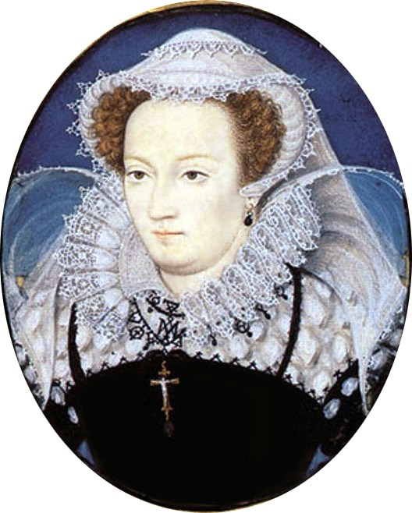
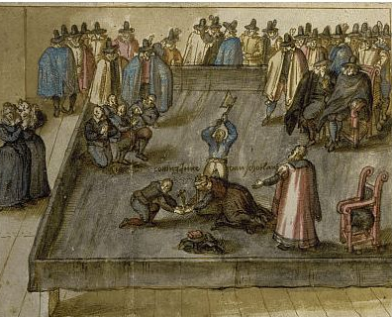
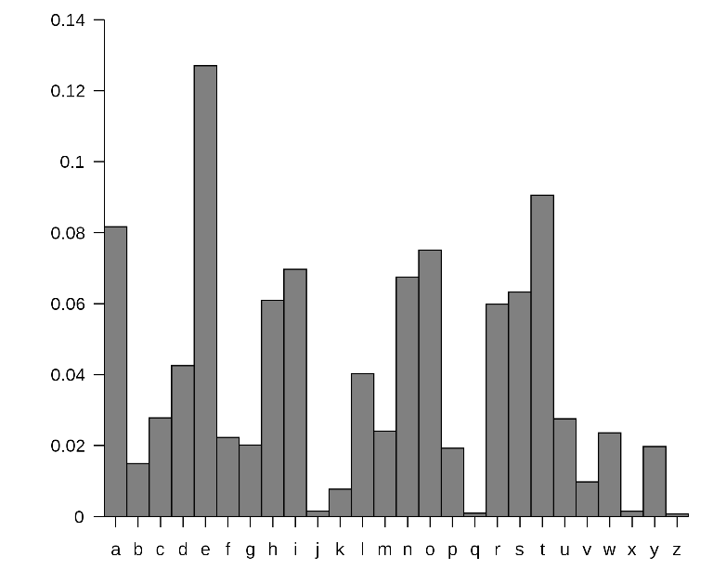
Example 1: Mary’s cipher
Mary queen of Scot planned to assassinate her cousin queen Elisabeth in 1587.
Communicated plot using substitution cipher
Sir Francis Walsingham broke it using frequency analysis

Slide 5
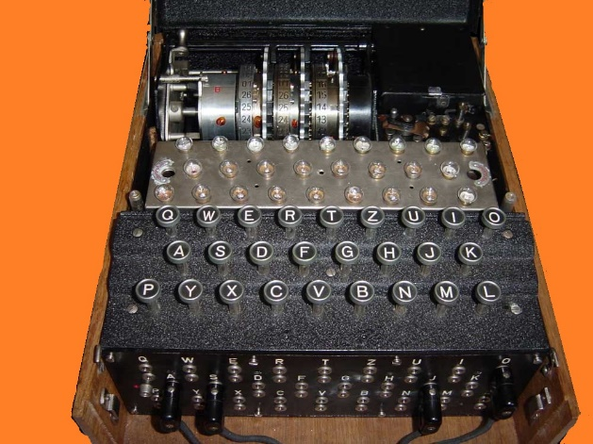
Example 2: Enigma
A typewriter* that based on wires and rotor setting would emit different letter for every keypress.
current state
new state
letter typed
letter output
About ${10}^{113}$ possibilities to set the wirings and rotors.
Lightspeed supercomputer will take ${≫10}^{17}$ years to check them all
(universe is only ${10}^{10}$ years old)
Believed impossible to break by Germans.
Broken via heroic efforts by British at Bletchley park
Cut German U-Boat success in sinking ships by ~90%
Sank about 60% of German U-Boats in Mediterranean
Crucial to success of Normandy D-day landing.

Slide 6
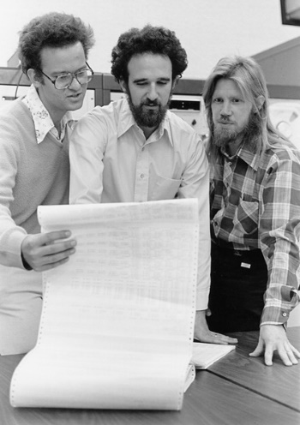
Modern Cryptography (1976- )
“We stand today on the brink of a revolution in cryptography”
Whit Diffie and Martin Hellman, 1976
Data
Cycles
Person-years
Result
Mary’s cipher
${10}^{4}$ bytes
N/A
$$1$$
Broken
Enigma
${10}^{7}$ bytes
$${10}^{13}$$
$${10}^{5}$$
Broken
1976
Diffie-Hellman/RSA
${10}^{18}$ bytes
$${10}^{25}$$
$${10}^{8}$$
Unbroken!
DH/RSA are simpler than Enigma, and allow public encryption key
Security through obscurity
Security through
mathematics
simplicity
Notes:
Yottabyte, exaflop

Slide 7
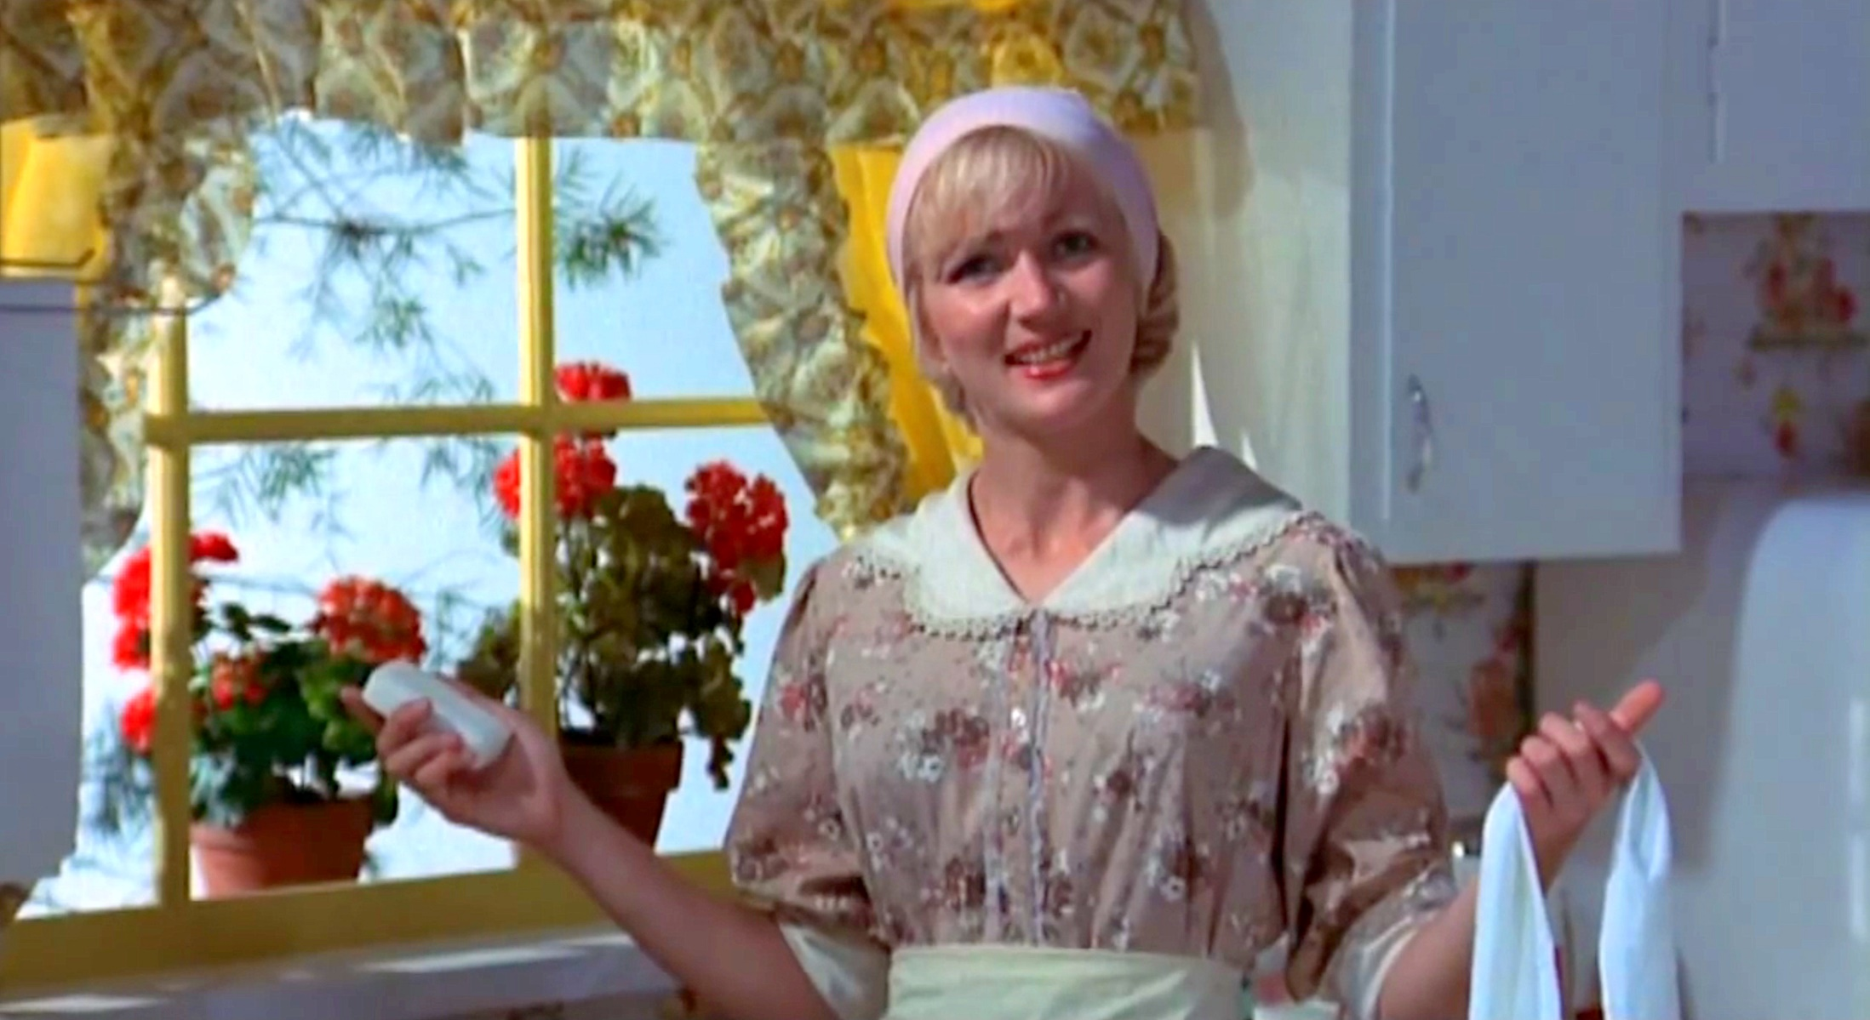
Cryptography and you
Homage to “Zinc Oxide and You” – Kentucky Fried Movie

Slide 16
This course:
Modern and “post modern” cryptography
Perfect security in an imperfect world
Standard undergrad crypto
Private key cryptography: confidentiality and integrity
Public key cryptography: security for the modern world
Really cool shit
Advanced topics: e-voting, e-cash, e-auctions
Quantum computing: breaking RSA/DH/ECC
Magic: fully homomorphic encryption, obfuscation
$⇒$ this course will be fast paced.

Slide 17
This is a proof based class.
Why?
Because I’m mean
Because you can’t experimentally demonstrate security.
What is a proof?
proof n. a sequence of statements, each of which is either validly derived from those preceding it or is an axiom or assumption, and the final member of which, the conclusion, is the statement of which the truth is thereby established.
A proof is a piece of English writing that convinces me, Tudor, Nathan and Mark that some fact X is true.
To write a proof:
1) First convince yourself beyond any doubt that X is true.
2) Then make this case to us clearly, precisely and concisely, without excessive formalism.
If you are not sure yourself, don’t try to convince us.
An unintelligible piece of writing is not a convincing argument, even if it doesn’t contain a formal bug.

Slide 18
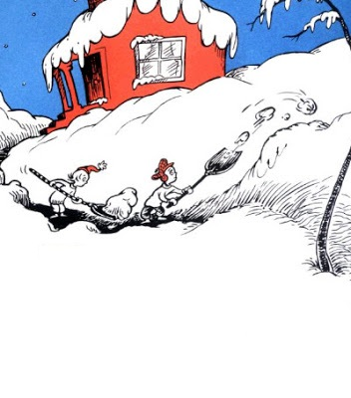
Surviving CS-127
This was no time for play. This was no time for fun. This was no time for games. There was work to be done.

Slide 19
Surviving CS-127
1) Do the reading before each lecture.
2) Do the reading before each lecture.
3) Eat your vegetables: go to lecture, do the P-sets.
4) Ask me (and your TF’s) questions! Here, office hours, sections, Piazza
Typical schedule (shopping week is different):
P-Sets: Due by Tue lecture.
Reading: Due before each lecture; short online quiz by Thu lecture.
This was no time for play. This was no time for fun. This was no time for games. There was work to be done.
You can (even should) do reading/P-sets in groups of $≤3$ students
Other components: Midterm, take home final, class/online participation

Slide 20
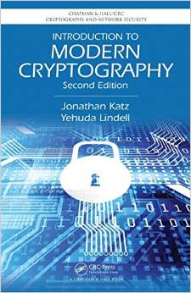
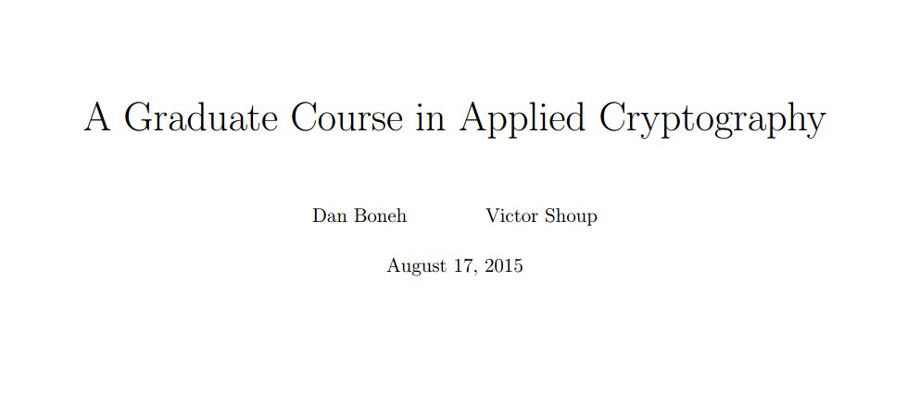
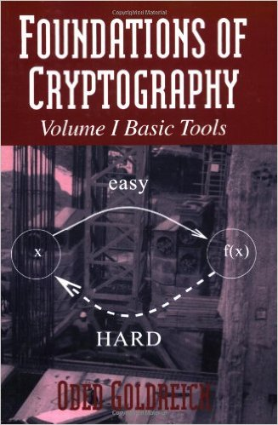
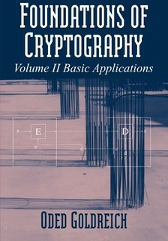
Additional resources

Slide 21
Defining encryption
Why do we need to formally define security?

Slide 22
Defining encryption
Alice
Bob
Ciphertext: $c=E_{k}(m)$
$$m=D_{k}(c)$$
Key: $k∈{\left\{0,1\right\}}^{n}$
Key: $k∈{\left\{0,1\right\}}^{n}$
Plaintext: $m∈{\left\{0,1\right\}}^{ℓ}$
Eve
Knows $E,D$
(no “security through obscurity”)
Only secret is $k$
$k$ is secret $=$ $k$ is chosen at random
No secrecy without randomness!!
$k$ is uniform in ${\left\{0,1\right\}}^{n}$ $⇒$ Probability of guessing it is $2^{−n}$

Slide 23
Defining encryption
Alice
Bob
Ciphertext: $c=E_{k}(m)$
$$m=D_{k}(c)$$
Key: $k∈{\left\{0,1\right\}}^{n}$
Key: $k∈{\left\{0,1\right\}}^{n}$
Plaintext: $m∈{\left\{0,1\right\}}^{ℓ}$
Eve
Attempt 1: $Pr⁡[$Eve guesses $k$ given $c]≤2^{−n}$
See the “2 to many” theorem in the lecture notes.
Problem: Could be hard to learn key, but easy to learn message.
Attempt 2: $Pr⁡[$Eve guesses $m$ given $c]≤2^{−n}$
Problem: What if $m$ is either “Yes” or “No”?
Probability over what?
Perfect Secrecy: $∀M⊆{\left\{0,1\right\}}^{ℓ}\underset{m←M,k←{\left\{0,1\right\}}^{n}}{Pr}⁡[$Eve guesses $m$ given $c]≤\frac{1}{\left|M\right|}$
Ciphertext $c$ reveals zero additional information about plaintext $m$

Slide 24
Perfect secrecy
$$m∈{\left\{0,1\right\}}^{ℓ},k∈{\left\{0,1\right\}}^{n}, D_{k}\left(E_{k}\left(m\right)\right)=m$$
$$1^{n}$$
$${E_{1^{n}}(m}_{0})$$
$$m_{0}$$
…
$$0^{n}$$
$$0^{n−1}1$$
ciphertexts
$2^{ℓ}$ plaintexts
$${E_{0^{n}}(m}_{0})$$
$$0^{n}$$
$${E_{0^{n}}(m}_{1})$$
$$m_{1}$$
…
$$1^{n}$$
$${E_{0^{n−1}1}(m}_{0})$$
$${=E_{1^{n}}(m}_{1})$$
Assume $E$ doesn’t ignore parts of key: $E_{k}\left(m\right)≠E_{k^{′}}\left(m\right)$ if $k≠k′$.
Claim 1: If $(E,D)$ perfectly secret then every ciphertext reachable from $m_{0}$ is also reachable from $m_{1}$
Claim 2: If for every $m_{0},m_{1}$ every ciphertext reachable from $m_{0}$ is also reachable from $m_{1}$ then $\left(E,D\right)$ is perfectly secret.

Slide 25
Unbreakable encryption
Theorem: $∃$ perfectly secret encryption.
Proof: One bit perfectly secret encryption:
$$k$$
$$0$$
$$1$$
$$0$$
$$0$$
$$m$$
$$0$$
$$0$$
$$1$$
$$1$$
$$1$$
$$1$$
$$1$$
$$0$$
Encrypt $ℓ$ bits $⇒$ repeat $ℓ$ independent keys
$$m∈{\left\{0,1\right\}}^{ℓ},k∈{\left\{0,1\right\}}^{ℓ}, E_{k}\left(m\right)=m⊕k$$
One time pad – used for U.S. and Soviet top secret communication.
“one time pad” $≈$ “point away from you gun”

Slide 26
Limitation of perfect security
Thm: If $(E,D)$ is perfectly secret then |key size|$≥$|message size|
Proof: $m∈{\left\{0,1\right\}}^{ℓ},k∈{\left\{0,1\right\}}^{n}$, suppose that $n<ℓ$
$$1^{n}$$
$$m_{0}$$
…
$$0^{n}$$
$$0^{n}$$
$2^{n}$ciphertexts
$2^{ℓ}$ plaintexts
$$0^{n−1}1$$
$$m_{1}$$

Slide 27
Summary
It is possible to mathematically define security for encryption
Guarantees encryption is unbreakable:
(for eavesdropping adversary)
No matter what Eve does, she can’t learn anything about the plaintext that she didn’t know before.
Requires key to be larger than message.
Huge problem in practice: we want $128$ bit key for gigabytes (if not terrabytes) of communication.

Slide 28
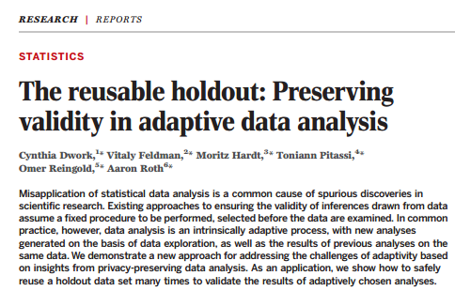
Overtime: Using the crypto mindset beyond crypto
One example: preventing overfitting in machine learning.
Training
Classifier
Idea: Treat training alg as attacker to prevent it learning “too much” about the particular sample.

